Slide 1
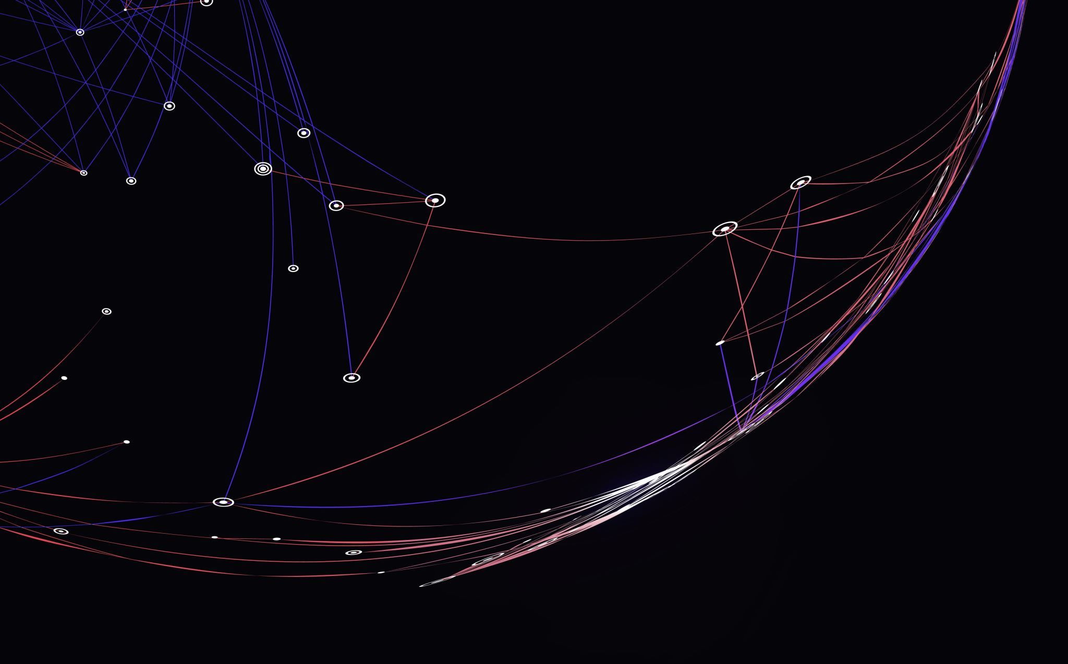
Tech Titans
A Creative Amalgamation of Ideas by Alessandro Pomponi, Luca Furino, Tioluwani Adesina, Michel Al Khouri

Slide 2
Ideas
Project Ideas | Description
Luca Furino: Spring-Block System Simulator | A program that provides visualization of a spring undergoing tension and compression from an attached mass. This project would incorporate physics principles such as Hooke’s Law and the Conservation of Energy.
Alessandro Pomponi: Projectile Motion Simulator | A program that demonstrates an animation based off projectile motion physics and works based off variables like initial velocity, angle, gravity, etc.
Tioluwani Adesina: Orbital Motion Simulator | The project is centered around developing a 2D gravity simulator using Java and JavaFX to demonstrate the effects of gravitational forces and orbital mechanics on bodies such as stars, planets, moons, and satellites (both natural and artificial) using physics laws such as Newton's Law of Universal Gravitation and Kepler's laws of planetary motion.
Michel Al Khouri: Projectile motion + spring | The project will have a ball being launched using a spring. It is a 2D project that will include wind resistance with a basket being at the other end of the screen. The user will have difficulty scoring the ball because the position.
Chosen Project: Spring Block + Projectile Motion | The program will be comprised of a spring system that will launch a ball based on user inputted values which will have the goal of hitting a specific destination. The program will also have the user try and obtain the greatest number of points possible in a limited time.

Slide 3
Physics Concepts
The core physics principles behind the project include:
Hooke's Law: F = − k ⋅ x
The Conservation of Energy:
Elastic Potential Energy: U = 1/2kΔx ²
Potential Energy: PE = m ⋅ g ⋅ h
Kinetic Energy: KE = 1/2mv ²
2-D Projectile Motion:
Equation of Motion in the X-Axis: x(t) = vₓ⋅ t
Equation of Motion in the Y-Axis: y(t) = hₒ + vᵧ ⋅ t - 1/2gt ²

Slide 4
Concept Aspects
The project seeks to provide a learning experience through a spring-block/projectile motion simulator.
The project itself does not so much solve a problem as it does provide a visual representation of the physics concepts mentioned in the previous slide.
The category would be interactive as it is the user themselves that guides the experience and because it is a game. It is the user that challenges themselves to see if they can score however many points in a given amount of time.
Interactive parameters that influence the on-screen animations include a wheel attached to the spring that the user can rotate which affects the degree of rotation, and the ability to manually pull back the spring, compressing it and controlling the amount of force it exerts.

Slide 5
Typical Input
User will input:
- The length the spring (x) will be pulled back.
Optional: Slide slider for length value.
- The spring value (k) of the spring.
- The gravity value.
- The angle of the spring.
Optional: Slide angle of the spring.

Slide 6
Expected Output
Visual Animation:
A ball showing the spring in projectile motion, dynamically updated based on user input.
Graphs:
Bar Graphs for Energy Representation:
• Energy Representation in Bar Graphs:
• A set of dynamic bar graphs will visualize energy values in real time:
Energy graphs (plotted in real-time as well as Real-time plotting of energy transformations) including:
• Elastic potential energy (spring’s stored energy).
• Kinetic energy (motion of the mass).
• Gravitational potential energy.
• Total mechanical energy (to visualize energy conservation or loss with damping).
• Each energy form is displayed as a separate line on the graph, color-coded for clarity.
Timer:
Timer showing the amount of time left on the user's current gameplay.

Slide 7
Expected Output
Labels and Fields:
• Displays real-time numerical values for displacement, velocity, and energy
Key Metrics:
• The simulation will calculate and display key physics metrics in real time, such as:
• Oscillation Period (T): The time it takes for one complete cycle of motion.
• Amplitude (A): The maximum displacement from the equilibrium position.
• Energy Values: Instantaneous values for kinetic, potential, and elastic potential energy.
User Interface Features :
Interactive Sliders
Slider to adjust spring constant (k) to make the spring stiffer or flexible
Sound Effects:
Provide auditory feedback to users during interactions and simulation events.
Enhance user engagement and make the simulation more immersive and interactive.

Slide 8
Feasibility
Elements:
Stage and Scene
Layout containers:
BorderPane, HBox, VBox
Shapes and Drawing:
Circle
Path, QuadCurveTo, CubicCurveTo
Controls:
Buttons, Sliders, TextFields, Listeners, Menu
Animation:
AnimationTimer, Timeline
Implementation:
MVC model:
Model: Physics/Math
View: UI layouts and design
Controller: Logic and UI bridge
FXML
JSON
Tasks:
Basic UI design/set up of scenes (1 – 2 weeks)
Creation of spring, ball and other UI components (1 – 2 weeks)
Implementation of physics logic and game logic (2 - 4 weeks)
Implementation of optional variables with the use of JSON and additional game options (1 – 2 weeks)
Finishing touches on design and style of the program (1 week)

Slide 9
Luca's Part
Equation of Motion in the X-Axis: x(t) = vₓ⋅ t :This equation describes the horizontal motion of the projectile.
Equation of Motion in the Y-Axis: y(t) = hₒ + vᵧ ⋅ t - 1/2gt ² This equation governs the vertical motion of the projectile.
User Interface: Simulator/Game Scene :This is the visual environment where the user interacts with the actual simulator/game.
2-D Projectile Motion Animation: Dynamically Update Projectile Positioning : In this component, the graphical representation of the projectile is continuously updated in the animation based on the calculated positions from the equations of motion. .

Slide 10
Alessandro's Part
Implement styling and set-up of physics scene/page.
Implementation difficulty level with JSON
Implementing the logic behind the energy conservation:
Energy values at a specific time based on the spring physics and projectile motion physics.
How the graphs dynamically demonstrate energy values as the animation changes.
Show and apply the concept of conservation of energy.

Slide 11
Tioluwani's Part
Implementing the logic for the spring and simulating/applying the physics of a mass-spring system
Based on Hooke’s Law (F = -kx) and the laws of motion
Shows the system’s displacement, velocity, and energy over time.
Apply physics laws such as:
Newton's 2nd Law (F= ma)
Energy Conservation(Potential(U),Kinetic(KE),Mechanical(E))
Oscillation Period( T)
Projectile Motion

Slide 12
Michel's Part
Visuals:
Part of three scenes: main menu, game screen, settings
Develop the core gameplay loop.
Ensure balance and fairness in game mechanics.
Enhance player agency to improve interactivity and decision-making.
Implement a structured progression system.
Integrate audio elements for an immersive experience.

